Slide 1

Computed Tomography at LLNL
Kyle Champley
PI in the Nondestructive Characterization Institute (NCI)
Signal and Imaging Processing Research Group Leader
Director of the Center for Advanced Signal & Imaging Sciences (CASIS)

Slide 2
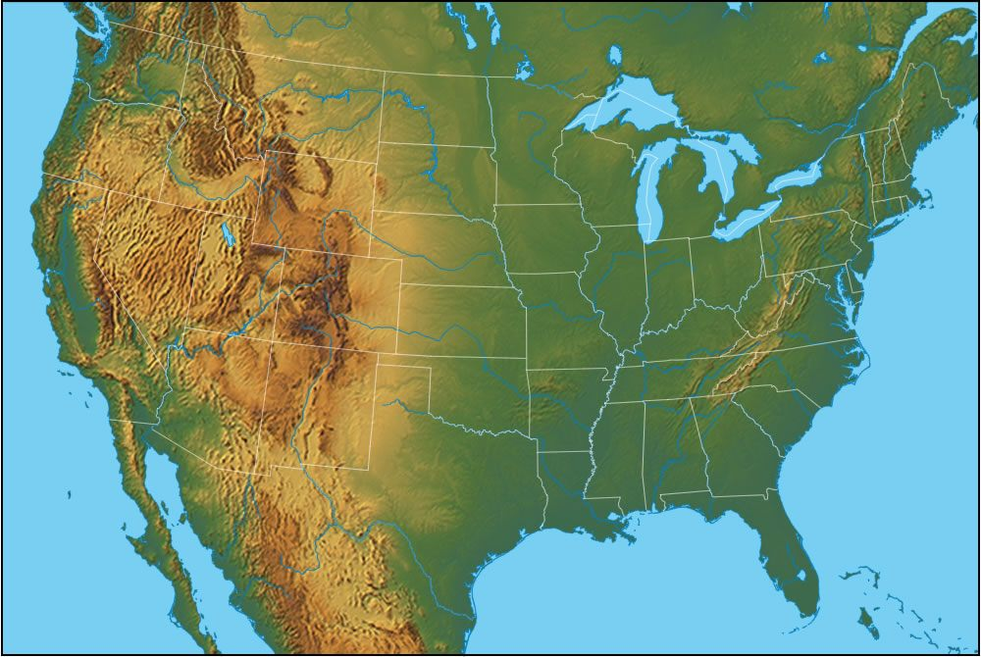
1997 - 2001
B.S. Mathematics/ Computer Science
Western Washington University

Slide 3
2002 - 2006
M.S. Mathematics
Oregon State University
Thesis
SPECT Reconstruction Using the Expectation Maximization Algorithm and an Exact Inversion Formula

Slide 4
2006 - 2010
Ph.D. Electrical Engineering
University of Washington
Real-Time analytic PET reconstruction for box geometries
Bayesian estimation method for depth of interaction estimation in PET detector
Dissertation
Algorithms for High-Resolution Positron Emission Tomography

Slide 5
2010 - 2012
CT Imaging Scientist
GE Global Research
Developed reconstruction algorithms for the GE Revolution CT system (wide cone 256-slice system)
Developed reconstruction algorithms for ultrasonic guided-wave system for monitoring pipe corrosion

Slide 6
2012 - present
Staff Scientist & Group Leader
Lawrence Livermore National Lab
Specializing in quantitative CT and sparse/ few-view CT reconstruction methods
Independent Contractor
Imatrex, Inc (EB-CT)
PET/X (Mammography/ PET)
Precision Sensing (SPECT)

Slide 7
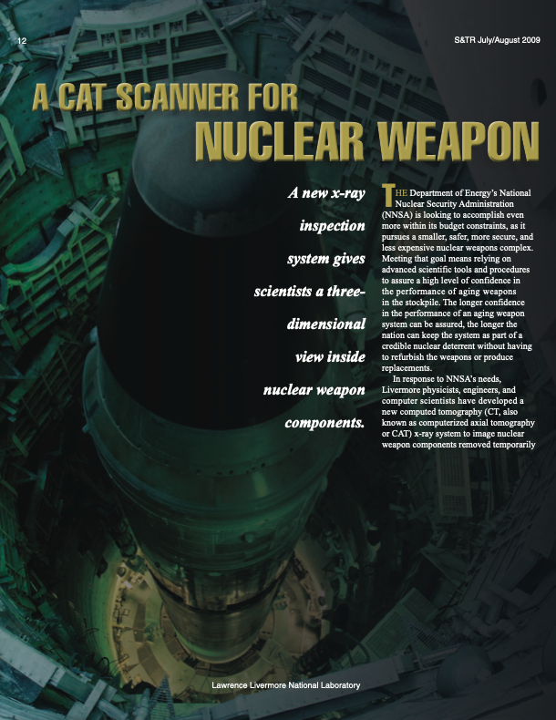
LLNL is a Federally Funded National Laboratory Specializing in National Security
Primary Customers
Nuclear Weapons Program
components must be inspected with NDE techniques
insensitive high explosives
Advanced Manufacturing (3D Printing)
metals and polymers
National Ignition Facility (NIF) and Photon Science
inspection is deuterium/tritium targets
Border and Aviation Security
R&D and testing/evaluation of scanners at seaports and airports
Nonproliferation and Treaty Verification

Slide 8
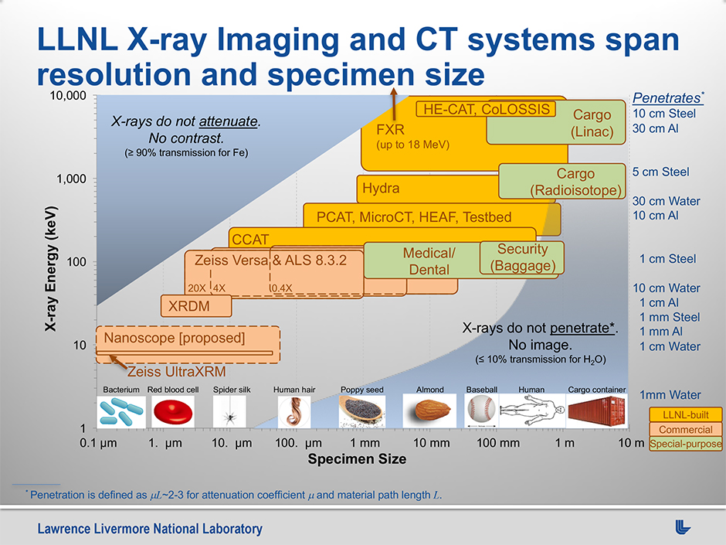

Slide 9
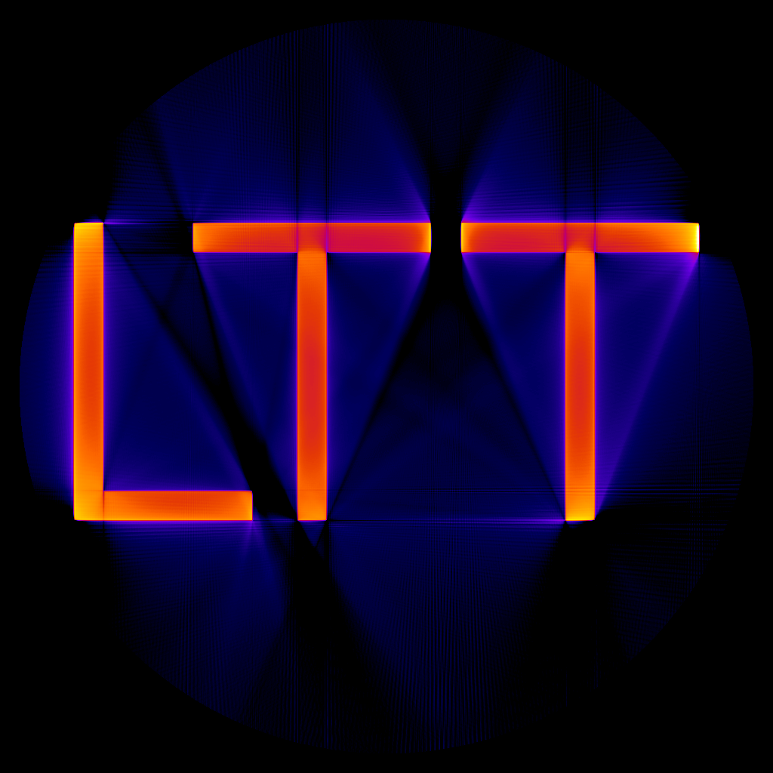
We desired a tomographic software toolkit capable of processing CT data for such diverse needs with exceptional quantitative accuracy… so we developed Livermore Tomography Tools

Slide 10
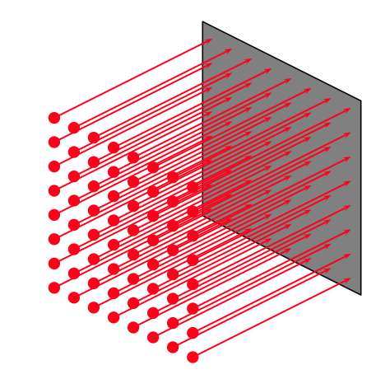
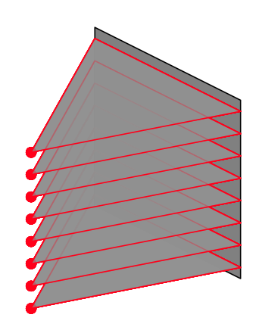
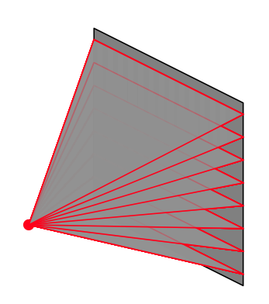
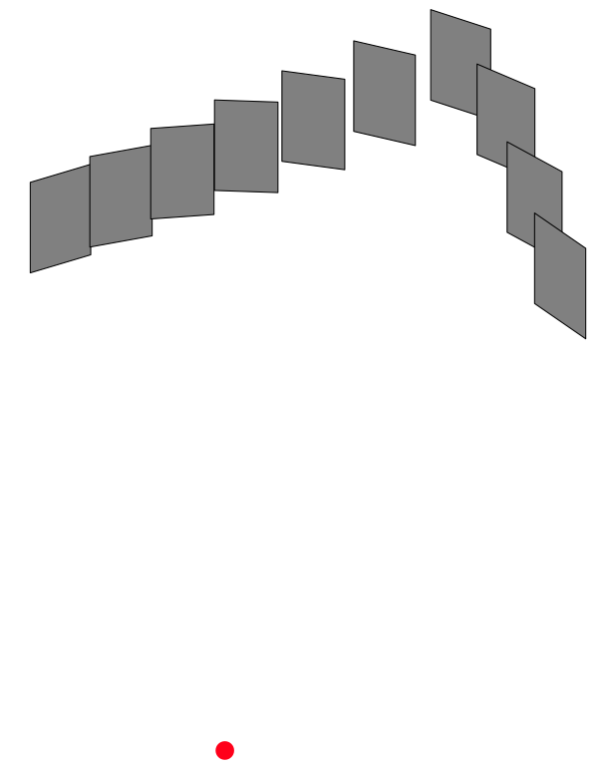



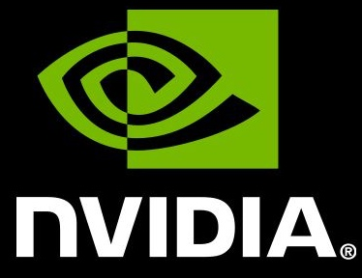


can process CT data from any scanner geometry
parallel
fan
cone
custom
on a computer running any OS
and any GPU/accelerator hardware vendor
with rapid processing and exceptional accuracy
(in specified units) using state of the art algorithms

Slide 11
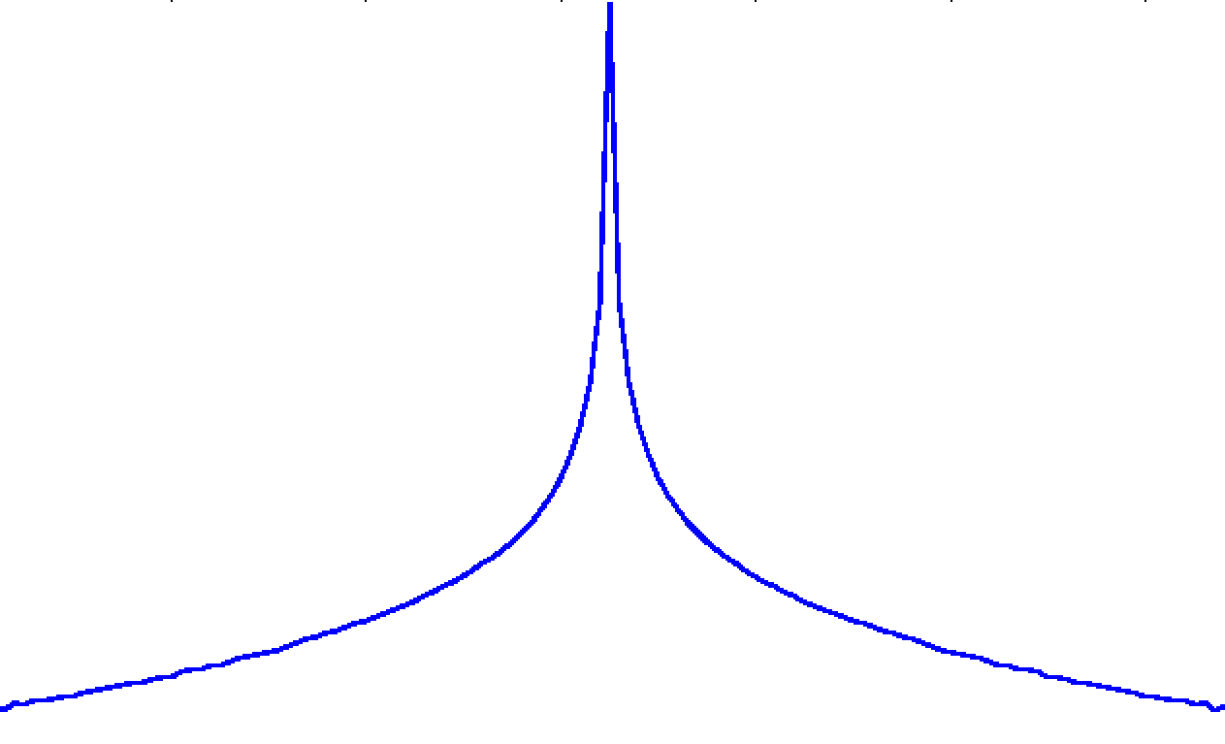
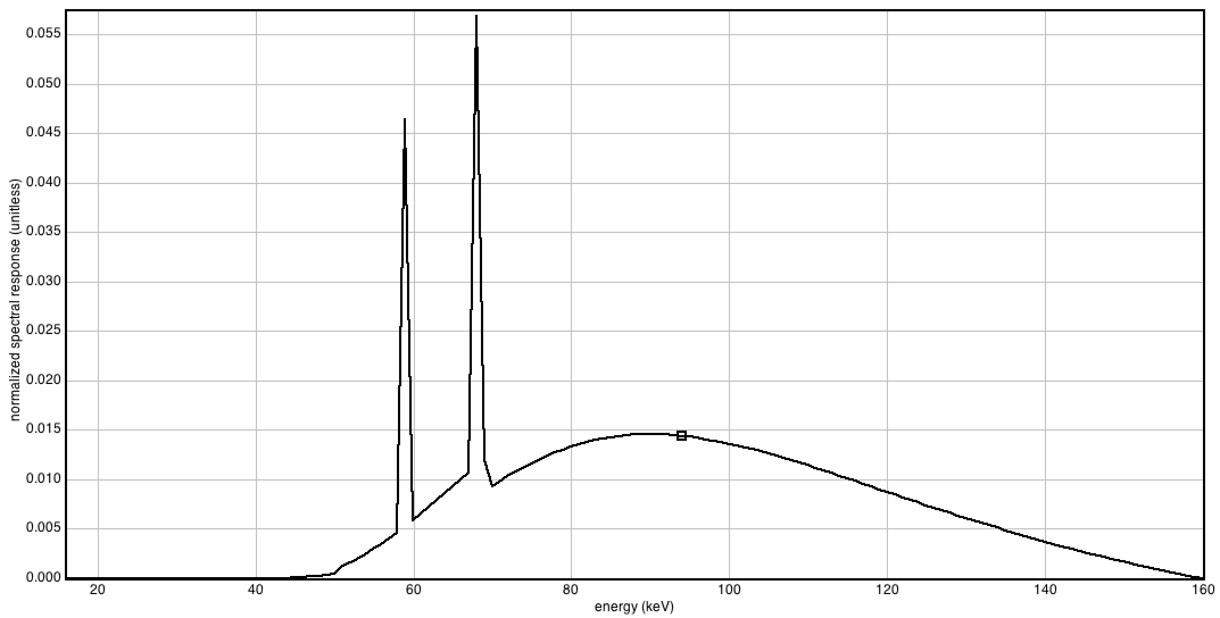
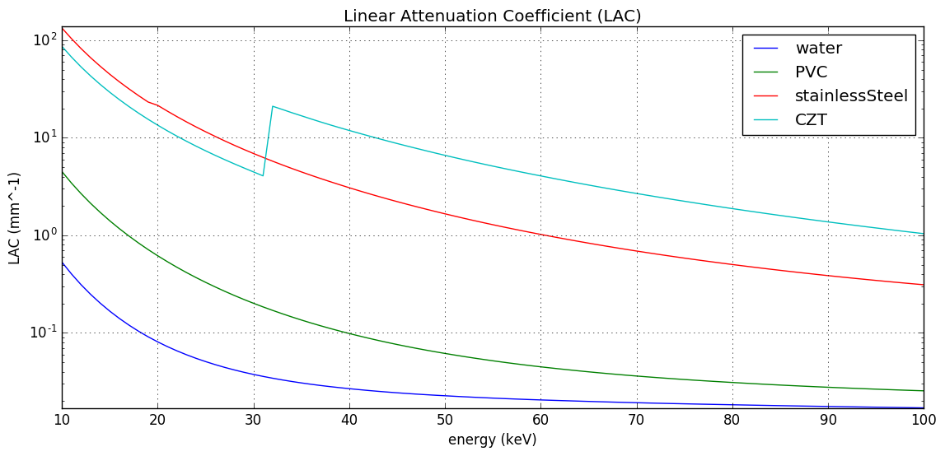
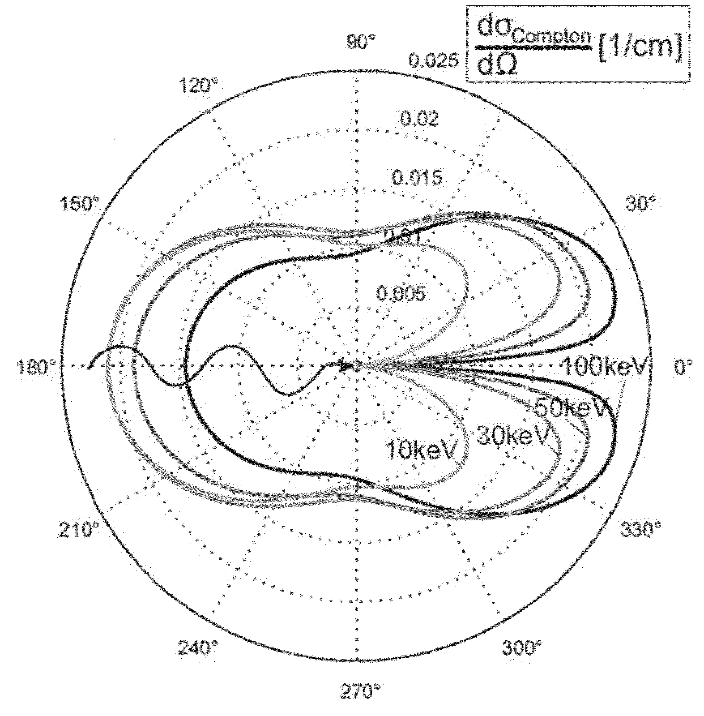
Quantitative CT
Detector Response versus Flux
detector PSF
raw CT data
Gain Correction
Detector Deblur
x-ray spectrum
x-ray cross sections
Multi-material Beam Hardening Correction
Scatter Correction
x-ray scatter distributions
x-ray spectrum
Reconstruction

Slide 12
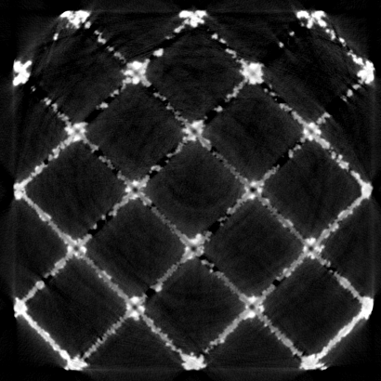
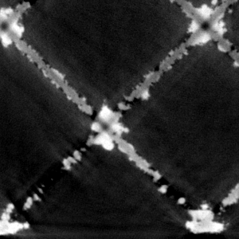
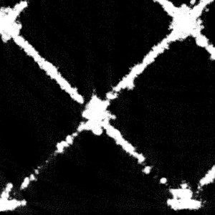
Physics-based algorithms remove beam hardening, scatter, and other effect that diminish quantitative accuracy and introduce artifacts
CT slice of Metal AM Lattice
Standard Reconstruction
Physics-Based Reconstruction
Red arrows point to artifacts
Green arrows point to true voids
Without physics-based algorithms, it is not possible to distinguish between artifacts and true features!

Slide 13
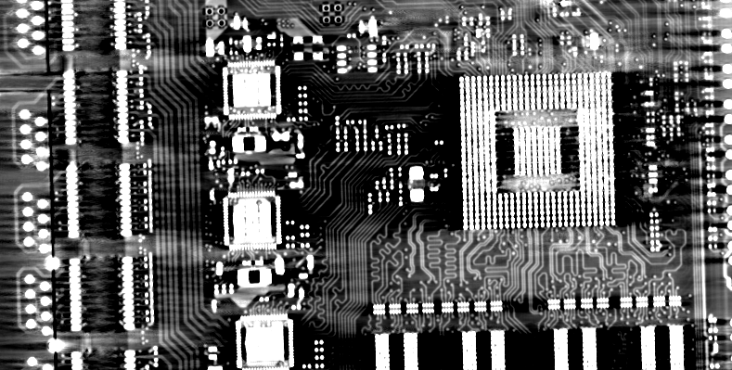
Standard Processing (FBP)
Metal streaks/ shading artifacts make it difficult to recover conductive traces in PBCs

Slide 14
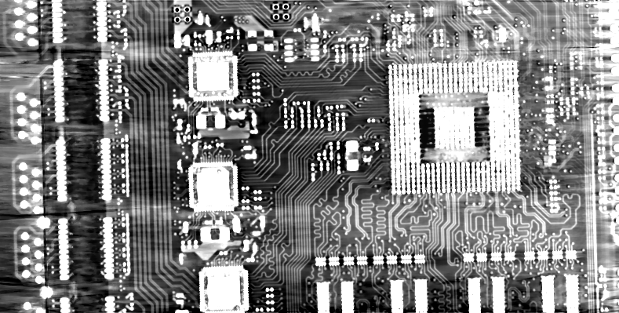
Physics-Based Correction Algorithms and Iterative Reconstruction
Physics-based iterative reconstruction algorithms in LTT provide best-in-class image quality

Slide 15
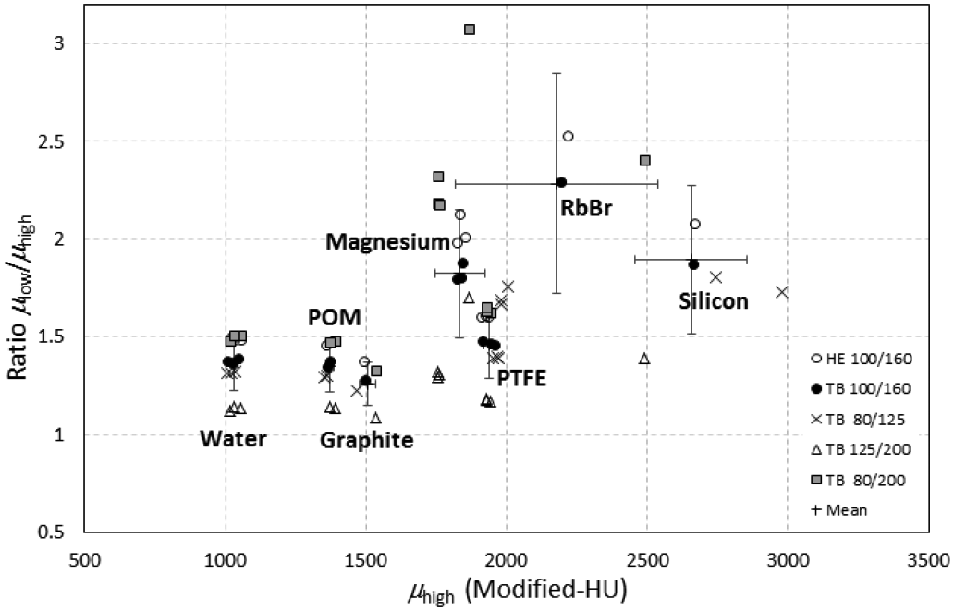
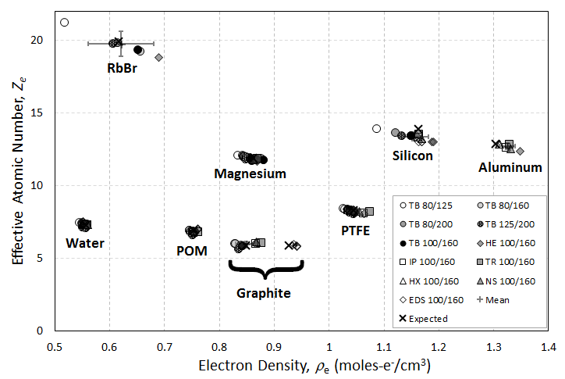
System Independent Rho-e/ Ze (SIRZ) (Electron Density/ Effective Atomic Number)
Quantitatively-accurate dual energy decomposition algorithms enabling estimation system independent material features
Conventional X-ray Feature Space
Rho-e/ Ze Feature Space
Used by DHS/TSA, FBI, and UK Home Office to characterize x-ray signatures of homemade explosives
Champley et al., IEEE TNS, 2019

Slide 16
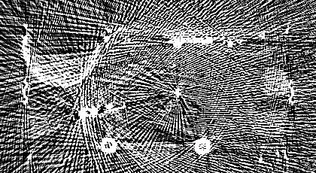
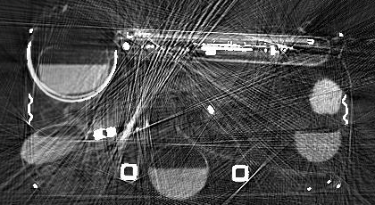
Metal Artifact Reduction (MAR) for airport luggage CT
Standard Processing
MAR
When luggage contains significant metal, reconstructions are nearly useless without MAR
Joint work with Seemeen Karimi

Slide 17
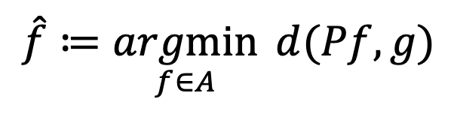
Sparse/ Few View CT reconstructing with 10-100 times fewer projections than conventional CT
Solve using constrained optimization
Distance Metric
$$\hat{f}≔\underset{f∈A}{argmin}{ d(Pf,g)}$$
Measured Data
Solution Space
Forward Model
Method to constrain solution space
Total Variation
Dictionary of Patches
Histogram Sparsity
Manifold of Solutions from Deep Learning
others

Slide 18
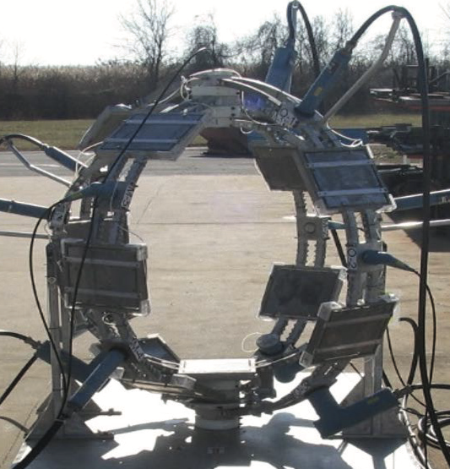
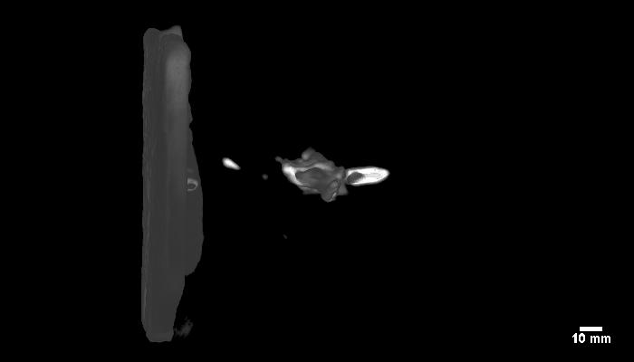
Reconstruction of armor-penetrating bullet with 5 truncated projections
ARL 15-head flash x-ray
Reconstruction using only the five 300 kV sources
Collaboration with Michael Zellner at the Army Research Laboratory (ARL)

Slide 19
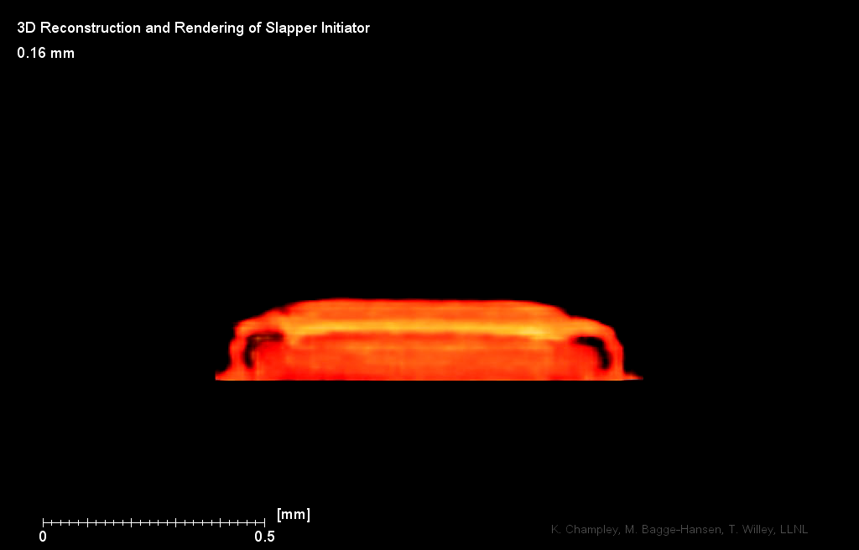
7-View Reconstruction of In-Flight (2.5 km/sec) Slapper Initiator
Willey, Champley, Hodgin, Lauderbach, Bagge-Hansen, May, Sanchez, Jensen, Iverson, van Buuren

Slide 20
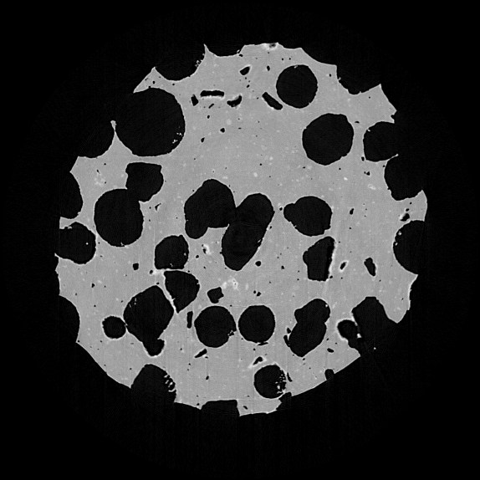

Our reconstruction shows good recovery of features from only 15 projections
Our reconstruction from 15-views with non-convex image priors
Reconstruction with 1440 views
only 15 projections of the original 1440 were used in this reconstruction

Slide 21

Our reconstruction outperforms other state of the art approaches
State-of-the-art reconstruction from 15 views
Our reconstruction from 15-views with non-convex image priors

Slide 22
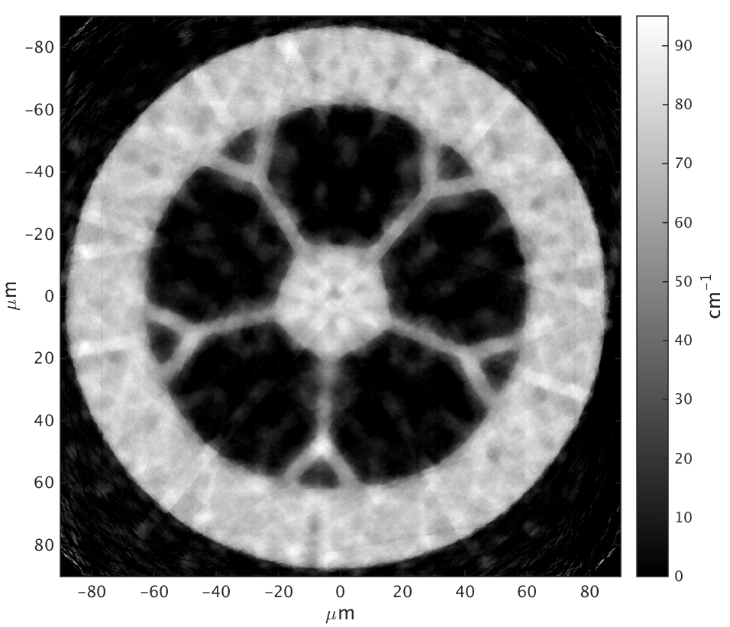
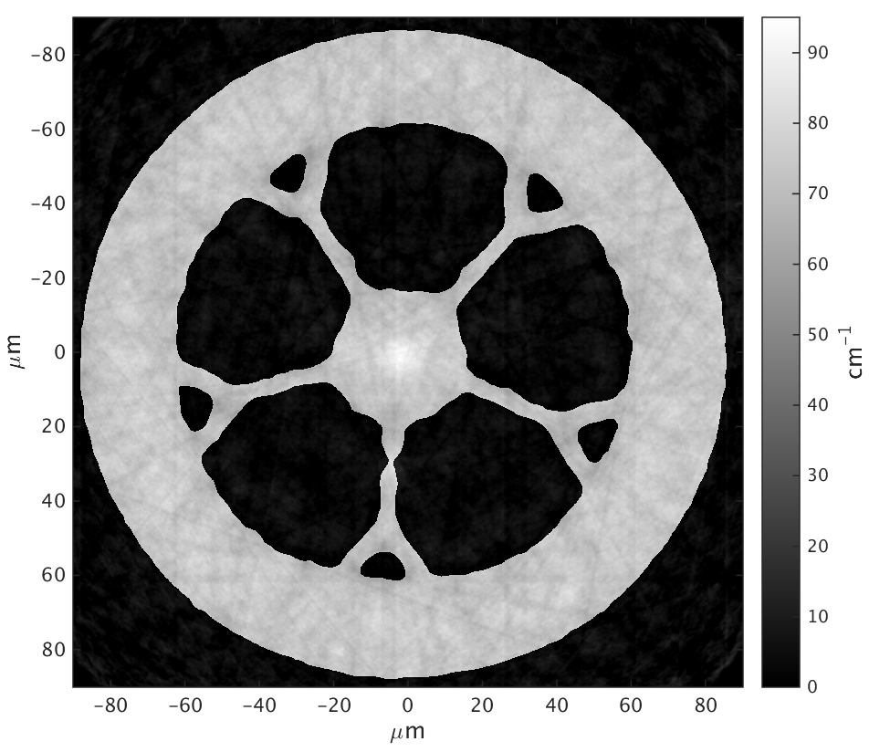
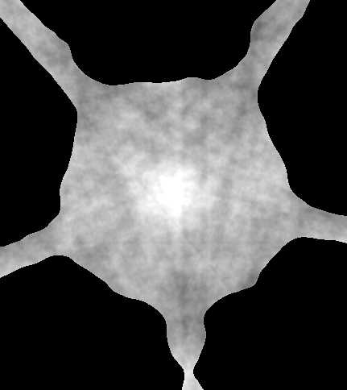
180 μm diameter glass fiber reconstruction with 19 views
State of the Art Method
LTT
the germanium-doped core is only visible with the LTT algorithm

Slide 23
Thank You!
NCI Website
https://nci.llnl.gov/

Slide 24
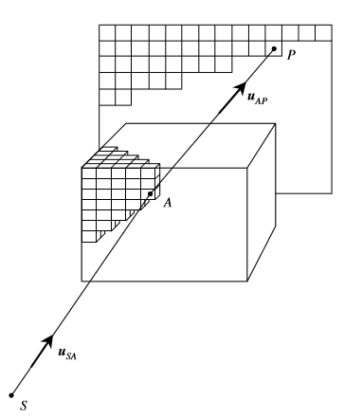
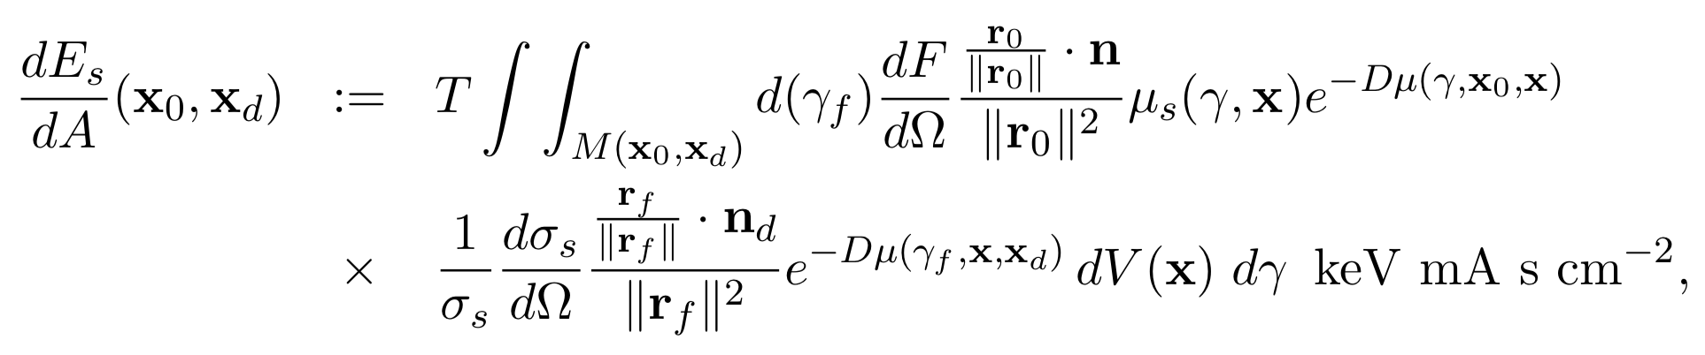
Physics-Based Scatter Correction
Model of First Order Scatter
x-ray flux per unit area
probability of scatter at x
probability no x-ray interaction before x
integration
time
detector
response
x_{d}
x
x
probability of scattering angle
probability no x-ray interaction from x to detector
Higher order scatter estimated by Monte-Carlo simulation. Estimate by a single number, so don’t need to simulate very many x-rays.
x₀

Slide 25
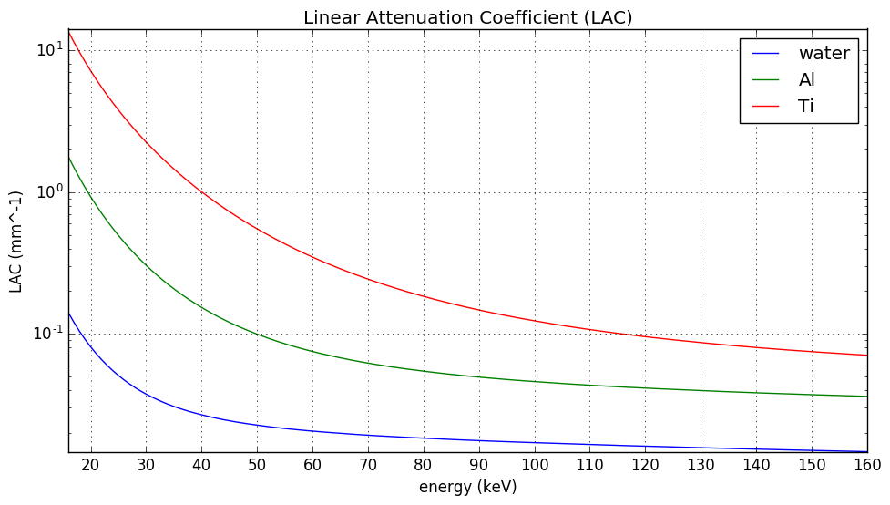
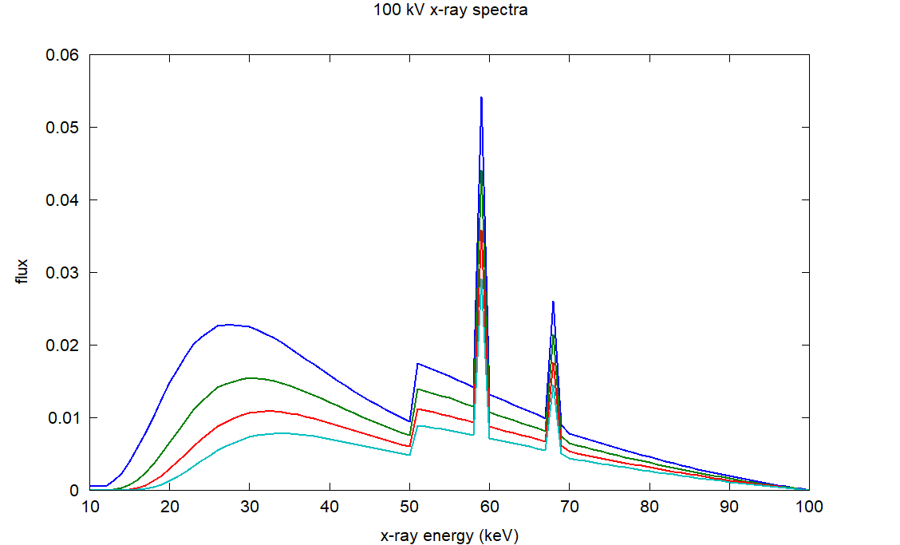
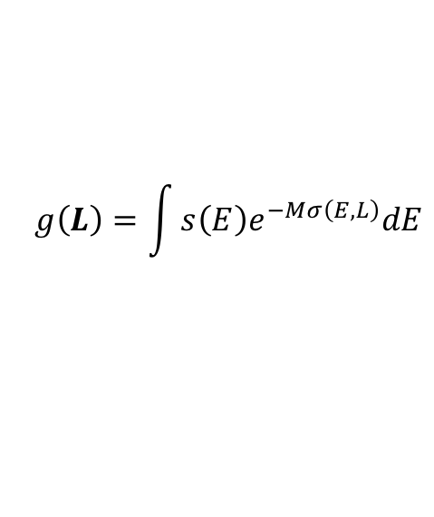
Beam Hardening is Caused by the Preferential Absorption of Low Energy X-rays
Mean Energies:
original spectrum: 45.5 keV
through 10 cm of water: 48.2 keV
through 20 cm of water: 50.2 keV
through 30 cm of water: 51.8 keV
measured
data
areal
density
original
10 cm water
$$g\left(L\right)=\int{s\left(E\right)e^{−Mσ\left(E,L\right)}dE}$$
20 cm water
30 cm water
spectrum
effective cross section

Slide 26

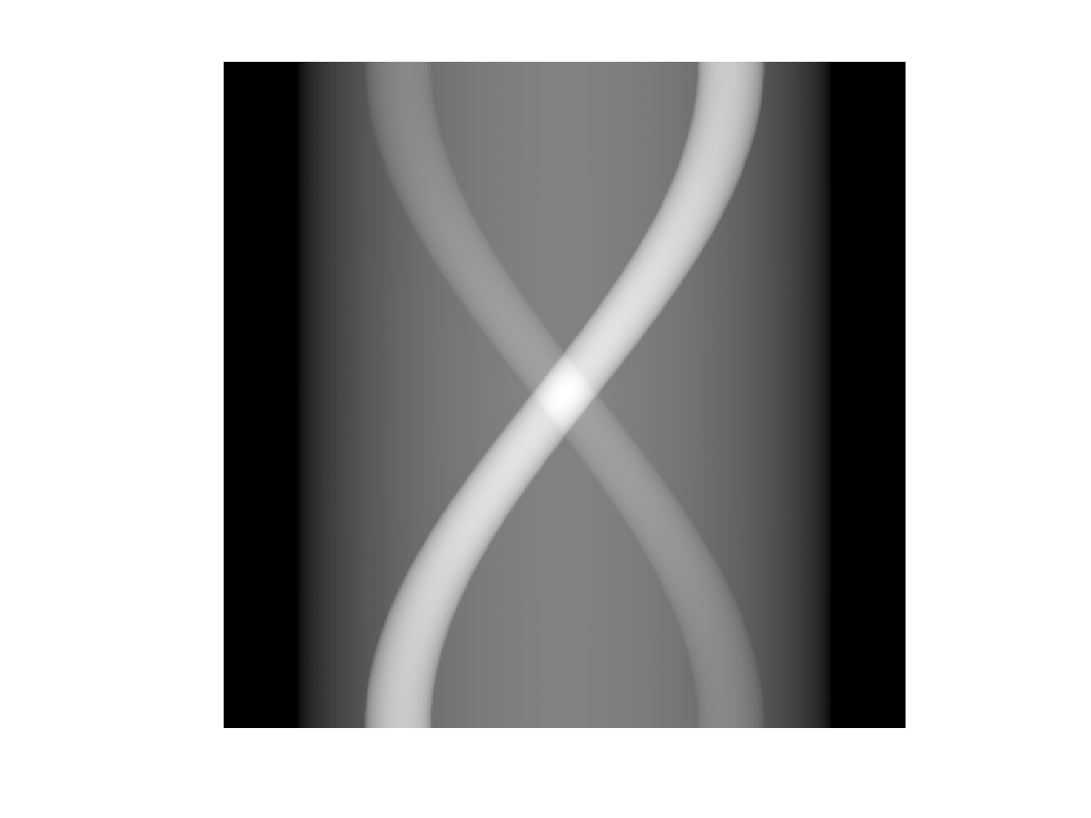

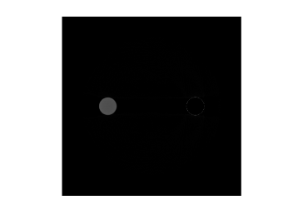







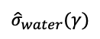
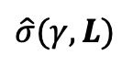
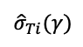
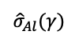
Multi-material Beam Hardening Correction
Sinogram Data
Initial Reconstruction
water
image
FBP
aluminum
image
titanium
image
$${\hat{σ}}_{water}(γ)$$
x
÷
forward projection
$${\hat{σ}}_{Al}(γ)$$
$$\hat{σ}(γ,L)$$
+
x
÷
forward projection
Estimate of cross section for each ray path can be used to remove beam hardening artifacts.
$${\hat{σ}}_{Ti}(γ)$$
x
÷
forward projection

Slide 27
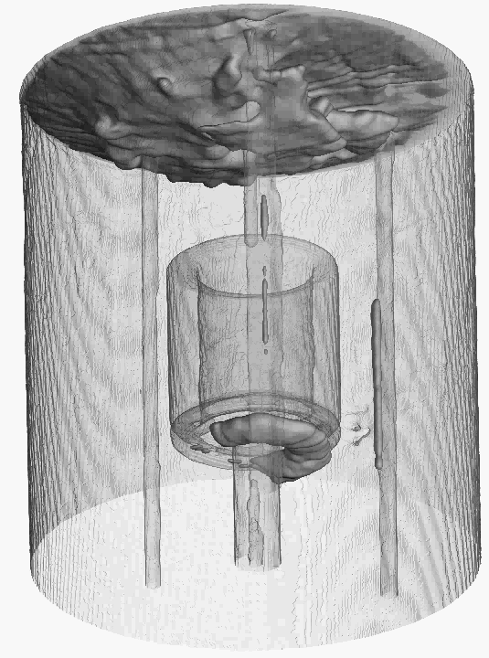
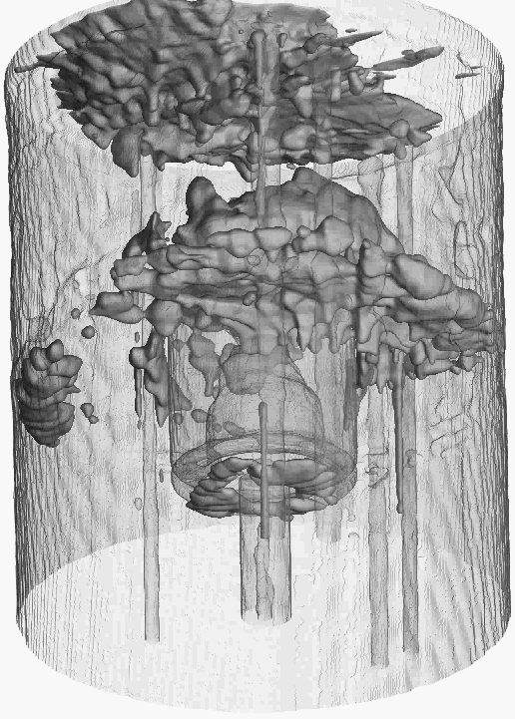
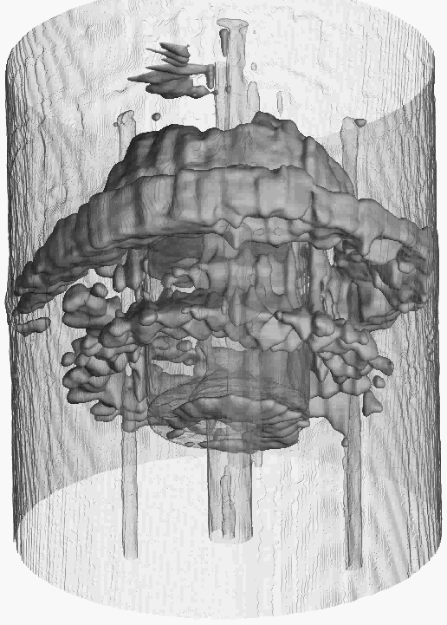
Dynamic CT of heating a sample (13 views per rotation/ 29 rotations)
initial state
middle state
final state

Slide 28
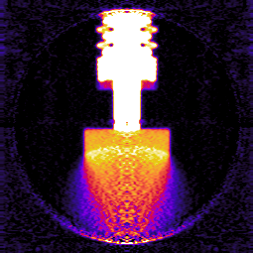
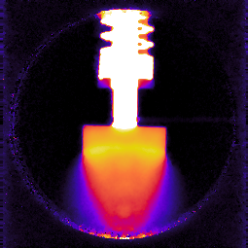
Detonation Experiment with DNTF reconstructions with a single projection
Abel Reconstruction
Iterative Reconstruction
Nielsen, Michael H., et al. "Single-bunch imaging of detonation fronts using scattered synchrotron radiation.” Journal of Applied Physics 123.22 (2018): 225902.

Slide 29
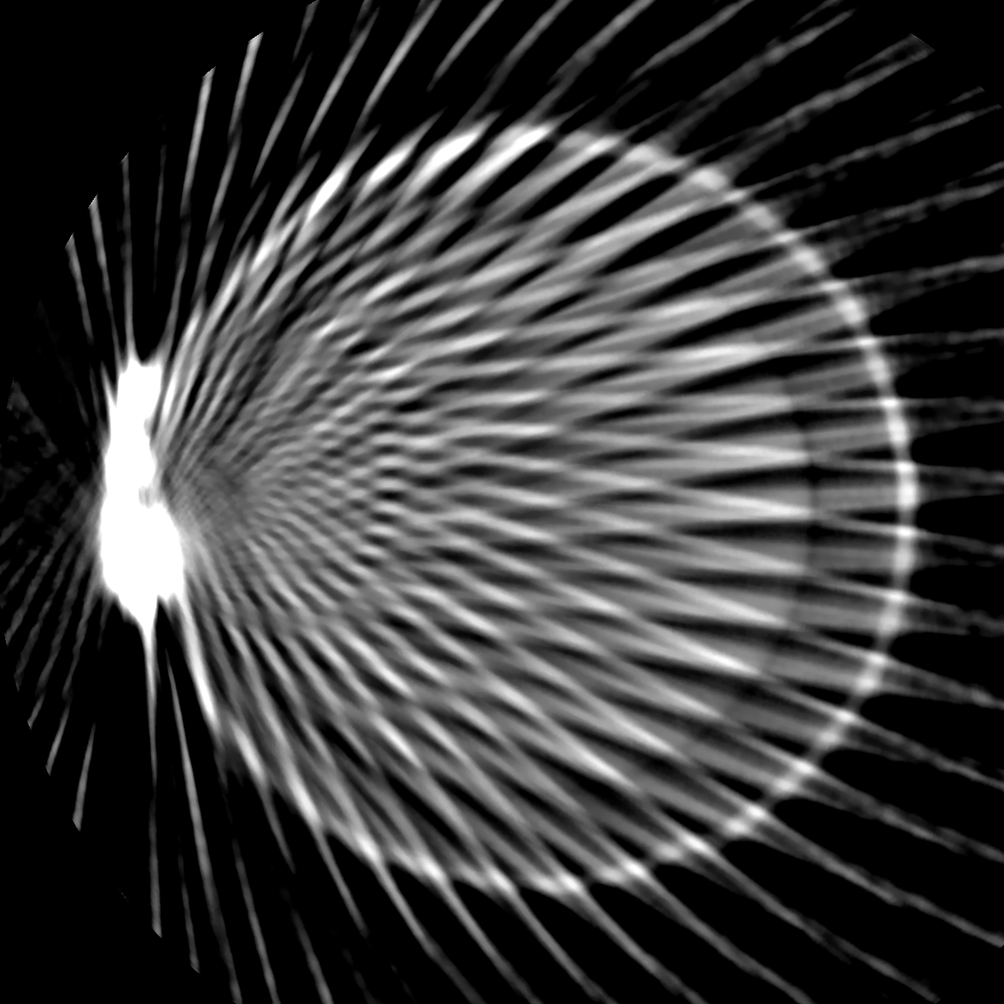
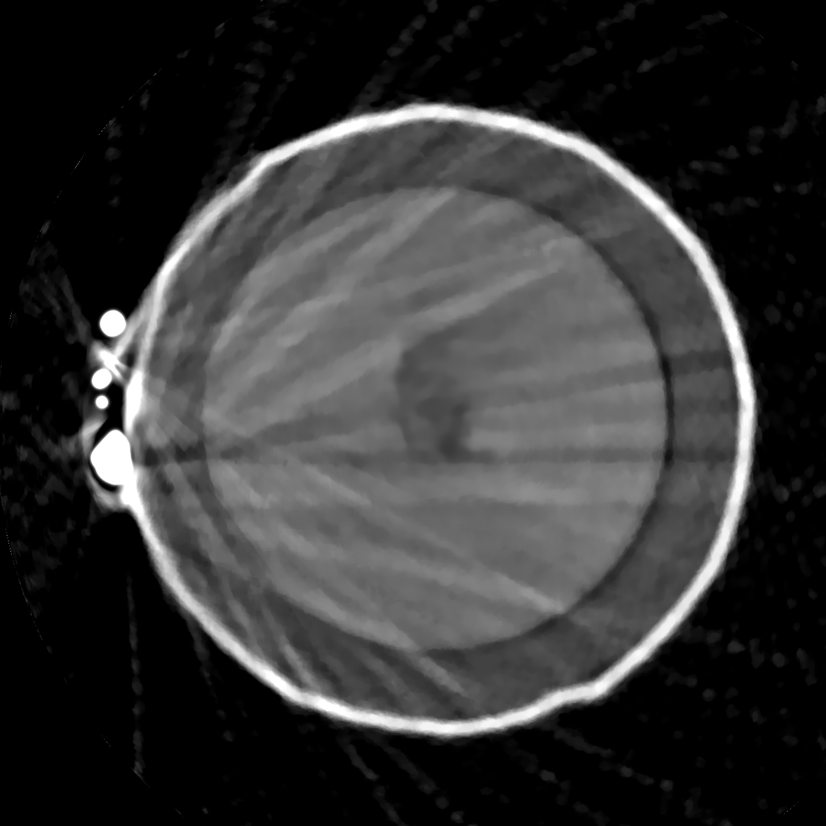
Reconstruction of industrial object with plastic and metal parts from 40 views
State of the Art Method
LTT

